Slide 1
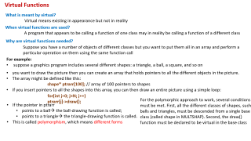
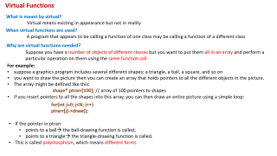
Virtual base class and virtual Functions

Slide 2
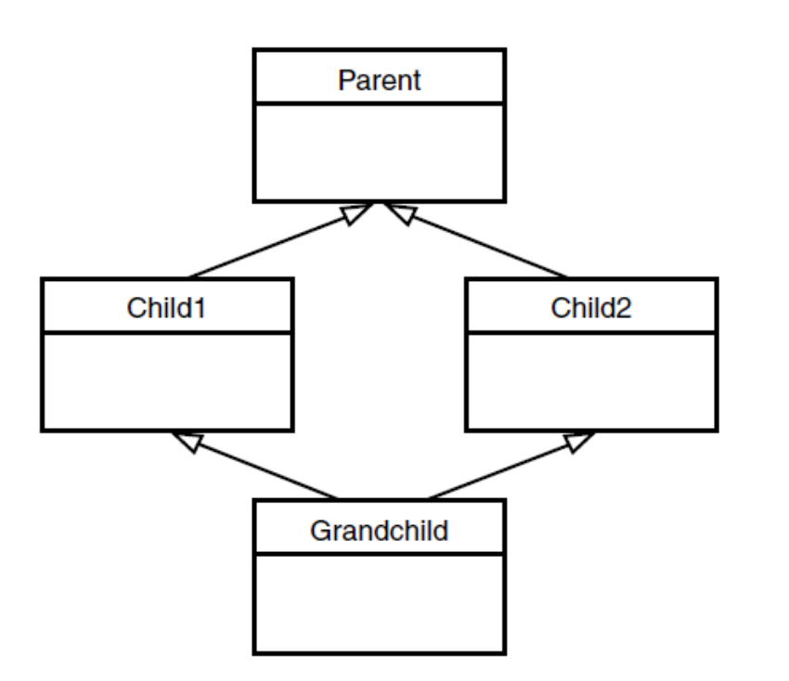
Virtual Base Classes-multiple inheritance
Consider the situation shown in Figure, with a base class, Parent; two derived classes, Child1 and Child2; and a fourth class, Grandchild, derived from both Child1 and Child2.
In this arrangement a problem can arise if a member function in the Grandchild class wants to access data or functions in the Parent class

Slide 3
Virtual Base Classes-multiple inheritance
Without virtual keyword
With virtual keyword
class Parent
{
protected:
int basedata;
};
class Child1 : public Parent
{ };
class Child2 : public Parent
{ };
class Grandchild : public Child1, public Child2
{
public:
int getdata()
{ return basedata; } // ERROR: ambiguous
};
class Parent
{
protected:
int basedata;
};
class Child1 : virtual public Parent // shares copy of Parent
{ };
class Child2 : virtual public Parent // shares copy of Parent
{ };
class Grandchild : public Child1, public Child2
{
public:
int getdata()
{ return basedata; } // OK: only one copy of Parent
};
A compiler error occurs when the getdata() member function in Grandchild attempts to access basedata in Parent.
The use of the keyword virtual in these two classes causes them to share a single common subobject of their base class Parent.
Since there is only one copy of basedata, there is no ambiguity when it is referred to in Grandchild.

Slide 4
Virtual Functions
What is meant by virtual?
Virtual means existing in appearance but not in reality
When virtual functions are used?
A program that appears to be calling a function of one class may be calling a function of a different class
Why are virtual functions needed?
Suppose you have a number of objects of different classes but you want to put them all in an array and perform a particular operation on them using the same function call
For example:
suppose a graphics program includes several different shapes: a triangle, a ball, a square, and so on
you want to draw the picture then you can create an array that holds pointers to all the different objects in the picture.
The array might be defined like this:
shape* ptrarr[100]; // array of 100 pointers to shapes
If you insert pointers to all the shapes into this array, you can then draw an entire picture using a simple loop:
for(int j=0; j<N; j++)
ptrarr[j]->draw();
If the pointer in ptrarr
  points to a ball→ the ball-drawing function is called;
  points to a triangle→ the triangle-drawing function is called.
This is called polymorphism, which means different forms

Slide 5
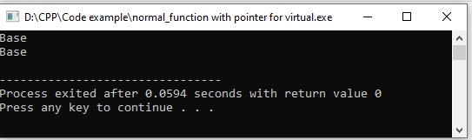
Normal Member Functions Accessed with Pointers
#include <iostream>
using namespace std;
class Base //base class
{
public:
void show() //normal function
{ cout << “Base\n”; }
};
class Derv1 : public Base //derived class 1
{
public:
void show()
{ cout << “Derv1\n”; }
};
class Derv2 : public Base //derived class 2
{
public:
void show()
{ cout << “Derv2\n”; }
};
int main()
{
Derv1 dv1; //object of derived class 1
Derv2 dv2; //object of derived class 2
Base* ptr; //pointer to base class
ptr = &dv1; //put address of dv1 in pointer
ptr->show(); //execute show()
ptr = &dv2; //put address of dv2 in pointer
ptr->show(); //execute show()
return 0; }
The function in the base class is always executed. The compiler ignores the contents of the pointer ptr and chooses the member function that matches the type of the pointer
Note:
The rule is that pointers to objects of a derived class are type compatible with pointers to objects of the base class

Slide 6
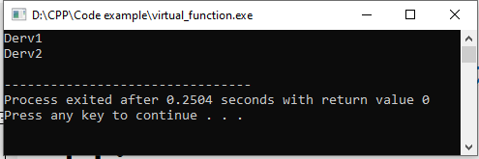
Virtual Member Functions Accessed with Pointers
#include <iostream>
using namespace std;
class Base //base class
{
public:
virtual void show() //virtual function
{ cout << “Base\n”; }
};
class Derv1 : public Base //derived class 1
{
public:
void show()
{ cout << “Derv1\n”; }
};
class Derv2 : public Base //derived class 2
{
public:
void show()
{ cout << “Derv2\n”; }
};
int main()
{
Derv1 dv1; //object of derived class 1
Derv2 dv2; //object of derived class 2
Base* ptr; //pointer to base class
ptr = &dv1; //put address of dv1 in pointer
ptr->show(); //execute show()
ptr = &dv2; //put address of dv2 in pointer
ptr->show(); //execute show()
return 0;
}
The member functions of the derived classes, not the base class, are executed.
We change the contents of ptr from the address of Derv1 to that of Derv2, and the particular instance of show() is executed (including changes)
Note: The rule is that the compiler selects the function based on the contents of the pointer ptr, not on the type of the pointer

Slide 7
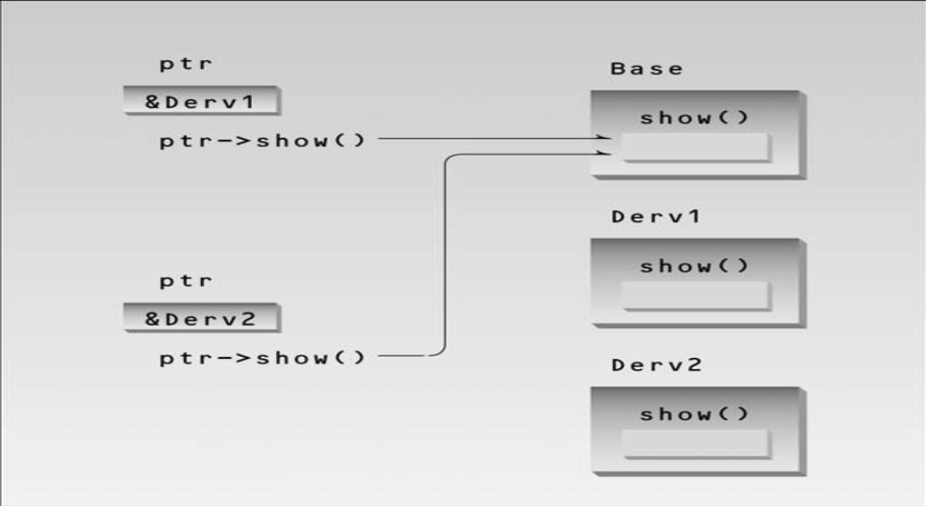
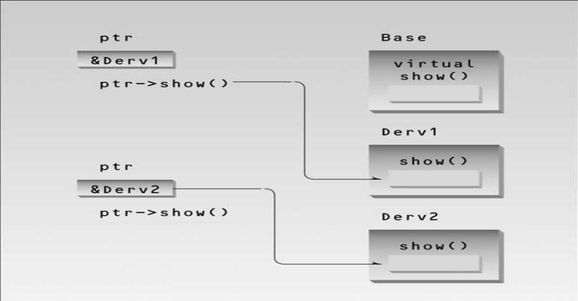
Nonvirtual pointer access
Virtual pointer access
Late Binding or dynamic binding
At runtime, when it is known what class is pointed to by ptr, the appropriate version of draw will be called
Choosing functions in the normal way, during compilation, is called early binding or static binding

Slide 8
Abstract Classes and Pure Virtual Functions
When we will never want to instantiate objects of a base class, we call it an abstract class.
Such a class exists only to act as a parent of derived classes that will be used to instantiate objects.
It may also provide an interface for the class hierarchy
How can we can do that?
By placing at least one pure virtual function in the base class.
A pure virtual function is one with the expression =0 added to the declaration.
Once you’ve placed a pure virtual function in the base class, you must override it in all the derived classes from which you want to instantiate objects.
If a class doesn’t override the pure virtual function, it becomes an abstract class itself and you can’t instantiate objects from it

Slide 9
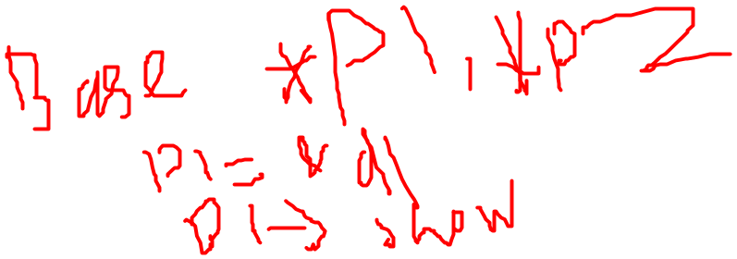
Abstract Classes and Pure Virtual Functions
#include <iostream>
using namespace std;
class Base //base class
{
public:
virtual void show() = 0; //pure virtual function
};
class Derv1 : public Base //derived class 1
{
public:
void show()
{ cout << “Derv1\n”; } };
class Derv2 : public Base //derived class 2
{
public:
void show()
{ cout << “Derv2\n”; } };
int main()
{
// Base bad; //can’t make object from abstract class
Base* arr[2]; //array of pointers to base class
Derv1 dv1; //object of derived class 1
Derv2 dv2; //object of derived class 2
arr[0] = &dv1; //put address of dv1 in array
arr[1] = &dv2; //put address of dv2 in array
arr[0]->show(); //execute show() in both objects
arr[1]->show();
return 0;
}
The addresses of the member functions are stored in an array of pointers and accessed using array elements. (like single pointer)
Note:
For consistency, you may want to make all the virtual functions in the base class pure

Slide 10
Virtual Functions and the person Class
class student : public person //student class
{
private:
float gpa; //grade point average
public:
void getData() //get student data from user
{
person::getName();
cout << “ Enter student’s GPA: “; cin >> gpa; }
bool isOutstanding()
{ return (gpa > 3.5) ? true : false; }
};
class professor : public person //professor class
{
private:
int numPubs; //number of papers published
public:
void getData() //get professor data from user
{
person::getName();
cout << “ Enter number of professor’s publications: “;
cin >> numPubs;
}
bool isOutstanding()
{ return (numPubs > 100) ? true : false; }};
#include <iostream>
using namespace std;
class person //person class
{
protected:
char name[40];
public:
void getName()
{ cout << “ Enter name: “; cin >> name; }
void putName()
{ cout << “Name is: “ << name << endl; }
virtual void getData() = 0; //pure virtual func
virtual bool isOutstanding() = 0; //pure virtual func
};

Slide 11
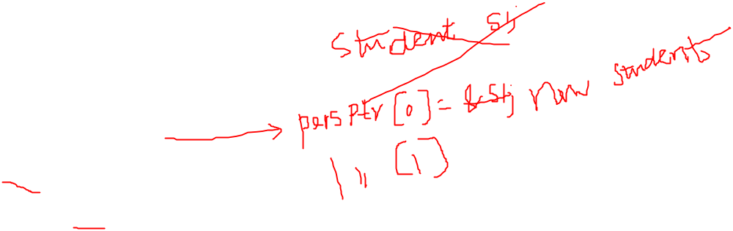
int main()
{
person* persPtr[100]; //array of pointers to persons
int n = 0; //number of persons on list
char choice;
do {
cout << “Enter student or professor (s/p): “;
cin >> choice;
if(choice==’s’) //put new student
persPtr[n] = new student; // in array
else //put new professor
persPtr[n] = new professor; // in array
persPtr[n++]->getData(); //get data for person
cout << “ Enter another (y/n)? “; //do another person?
cin >> choice;
} while( choice==’y’ ); //cycle until not ‘y’
for(int j=0; j<n; j++) //print names of all
{ //persons, and
persPtr[j]->putName(); //say if outstanding
if( persPtr[j]->isOutstanding() )
cout << “ This person is outstanding\n”;
}
return 0;
} //end main()

